Slide 1

FACULTY OF ENGINEERING
DEPARTMENT OF COMPUTER ENGINEERING
TITLE:
DEVELOPMENT AND IMPLEMENTATION OF A ROBOTIC APPLICATION FOR HUMAN INTENTION RECOGNITION USING MOTION AND HAND GESTURE
A Project Work Topic Proposal in Partial Fulfillment of the requirements for BSc. Computer Engineering
PRESENTATION BY:
ELEANA OSEI OWUSU-4121230024
JOEL NII ADJETEY AHULU- 4122530020
GHANA COMMUNICATION TECHNOLOGY UNIVERSITY

Slide 2
PRESENTATION OUTLINE
Introduction Problem Statement Objectives of Study Significance of Study Research Gaps Literature Review Methodology System Architecture | Hardware and Software Components Dataset Preparation and Gesture Recognition SLAM Testing and Results Conclusion Future works References

Slide 3
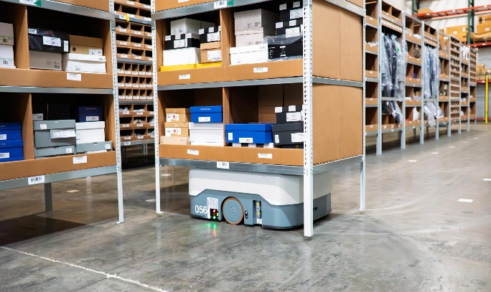
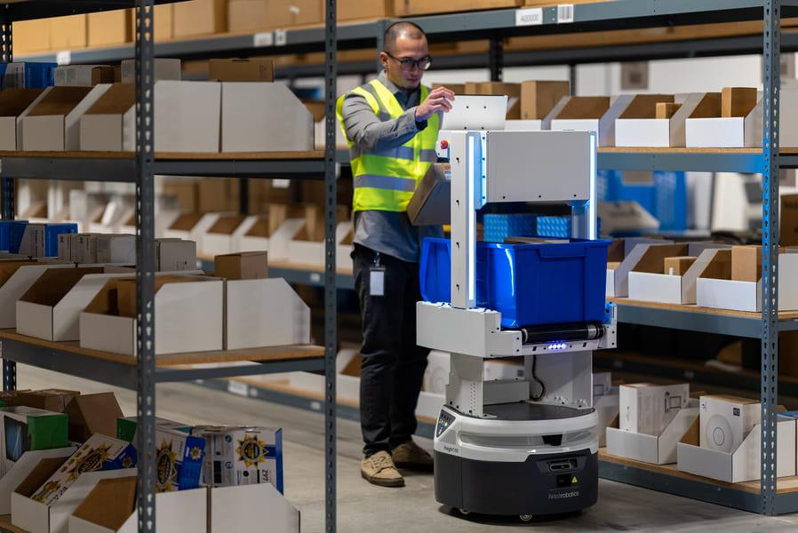
INTRODUCTION
Human–Robot Interaction (HRI) enables robots to understand and respond to human actions.
Gestures and body movements provide natural, contactless control.
Vision-based systems can require high computing power..
Edge computing supports real-time processing on low-power robots.
This project combines intention recognition, environmental awareness, and navigation.
Figure 1: Autonomous Mobile Robot Performing Navigation Tasks
Figure 2: Human Interaction with an Autonomous Mobile Robot Interface

Slide 4
Problem Statement
Existing systems often separate gesture recognition and navigation.
High computing demands limit edge deployment.
Cloud dependence affects real-time operation.
Data mismatch can reduce recognition accuracy.
Limited environmental awareness creates safety risks.

Slide 5
OBJECTIVES
.
General Objective
To design, implement and evaluate an edge-based real-time human intention recognition system integrating hand gestures and autonomous navigation using ROS 2..
Specific Objectives
Develop a real-time landmark-based MLP gesture classifier.
Train a reliable classifier using a balanced custom dataset.
Implement multi-node communication and centralized decision-making.
Integrate SLAM and navigation for gesture-directed movement.
Measure accuracy, latency and hardware performance.
Develop an LSTM model for short-term human movement prediction

Slide 6
SIGNIFICANCE OF THE STUDY
RESEARCH GAPS
Existing systems often treat recognition and navigation separately.
Some systems depend on cloud or powerful GPUs.
Some lack environmental awareness.
Few combine intention recognition with navigation.
his study integrates these functions on an edge robot
Reduces dependence on cloud computing.
Enables contactless robot control.
Supports industrial and healthcare applications.
Improves human–robot interaction.
Enables AI processing on edge devices

Slide 7
LITERATURE REVIEW
Ref / Year | Author(s) | Topic | Objectives | Methodology | Identified Gaps
[1] 2022 | Tsitos et al. | Real-time Feasibility of a Human Intention Method Evaluated Through a Competitive Human-Robot Reaching Game | Predict human intention in real time. ing a single RGB-D camera | OpenPose, RGB-D camera, ML models, ROS, UR3 robot. | Limited integration of multimodal human intention recognition.
[2] 2022 | Mahmud et al | 3D Gesture Recognition and Adaptation for Human–Robot Interaction | Recognize 3D gestures for robot control. | Kinect, HMM, SVM, CNN, robot navigation. | Depends on Kinect, reducing portability and affordability. Requires specialized 3D sensing hardware. Limited applicability to low-cost edge computing platforms.
[3] 2023 | Yang et al. | Safe and Efficient Motion Planning for Material Transportation Robots Considering Intention Prediction of Obstacles | Predict obstacle intentions for safe navigation. | Object detection, ReLU intention model, Nav2, ROS2. | Focuses on obstacle intention prediction rather than direct human gesture recognition.

Slide 8
METHODOLOGY
System Architecture
Hardware & Software Setup
Dataset Collection and Preprocessing
Gesture Recognition Pipeline
Brain Node Decision Making
ROS2 Integration
SLAM & Navigation

Slide 9
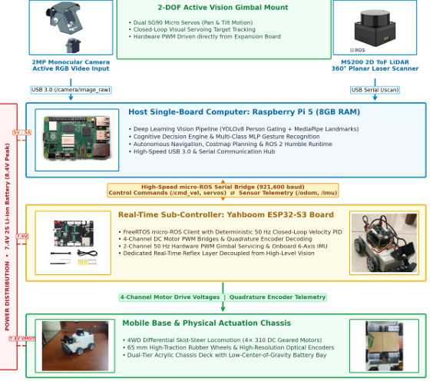
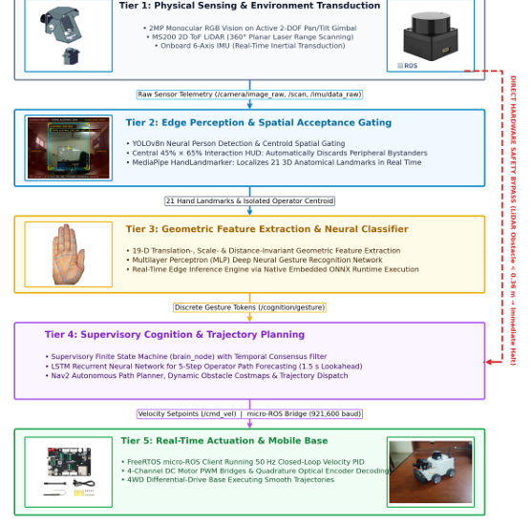
SYSTEM ARCHITECTURE
Figure 3:Hardware Architecture and Signal distribution
Figure 4: System Architecture

Slide 10
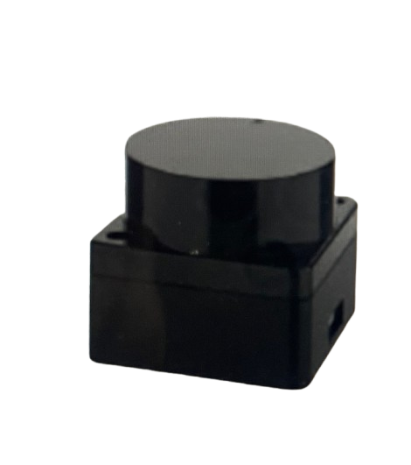
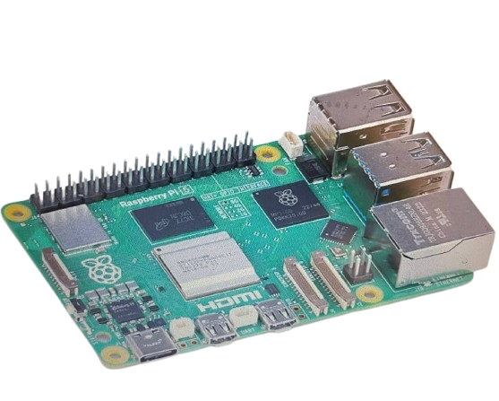
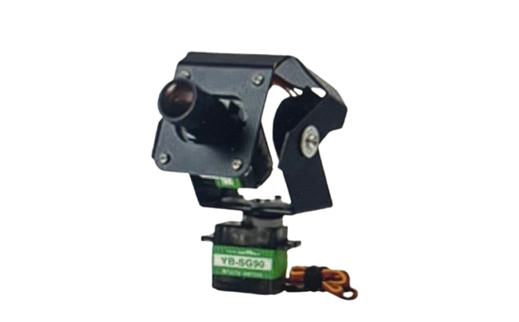
HARDWARE COMPONENTS
Figure 5: Raspberry Pi 5 :Raspberry Pi 5: Main computer that processes AI, camera, LiDAR, and SLAM data directly on the robot..
Figure 6: USB Camera :
Captures gestures and keeps the user centered for tracking.
Figure 7: M200 LiDAR Sensor The LiDAR detects obstacles, supports SLAM mapping, and stops the robot within the 0.36 m safety zone.”
.

Slide 11
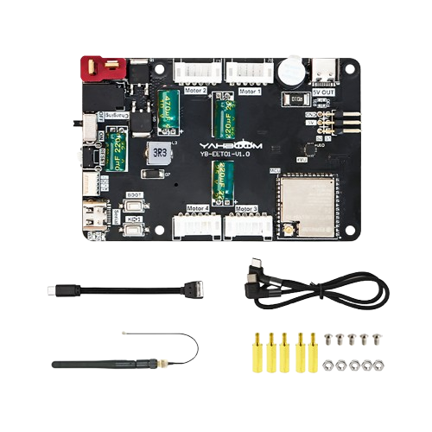

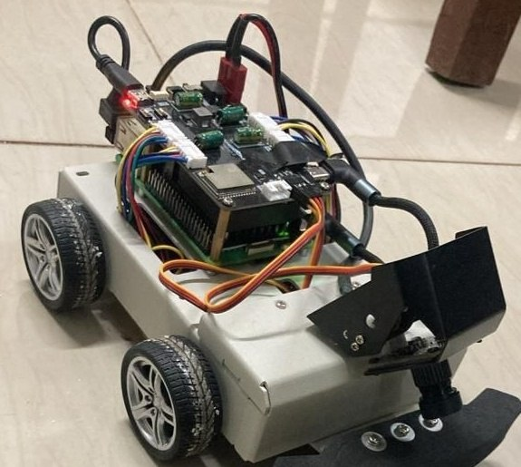
HARDWARE COMPONENTS
Figure 8: Power Supply/Battery :Uses a 7.4V rechargeable battery with separate power for the motors and Raspberry Pi..
Figure 9:Uses a Yahboom MicroROS-Pi5 differential-drive robot with four geared motors and wheel encoders..
Figure 10: The Micro-ROS board controls the motors and sensors. It uses an ESP32-S3 and communicates with the Raspberry Pi.”

Slide 12
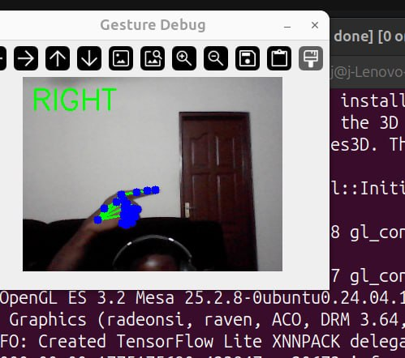
DATASET PREPARATION AND GESTURE RECOGNITION PIPELINE
6,000 samples collected from the robot’s own camera.
6 gesture classes: Stop, Go, Left, Right, Back, Follow.
Balanced dataset: 1,000 samples per gesture.
MediaPipe extracts 21 hand landmarks
Landmarks are converted into 19 normalized geometric features
MLP classifier recognizes the six gestures..
Figure 11:Live System Demonstration: The detected gesture is classified and displayed in real time.

Slide 13
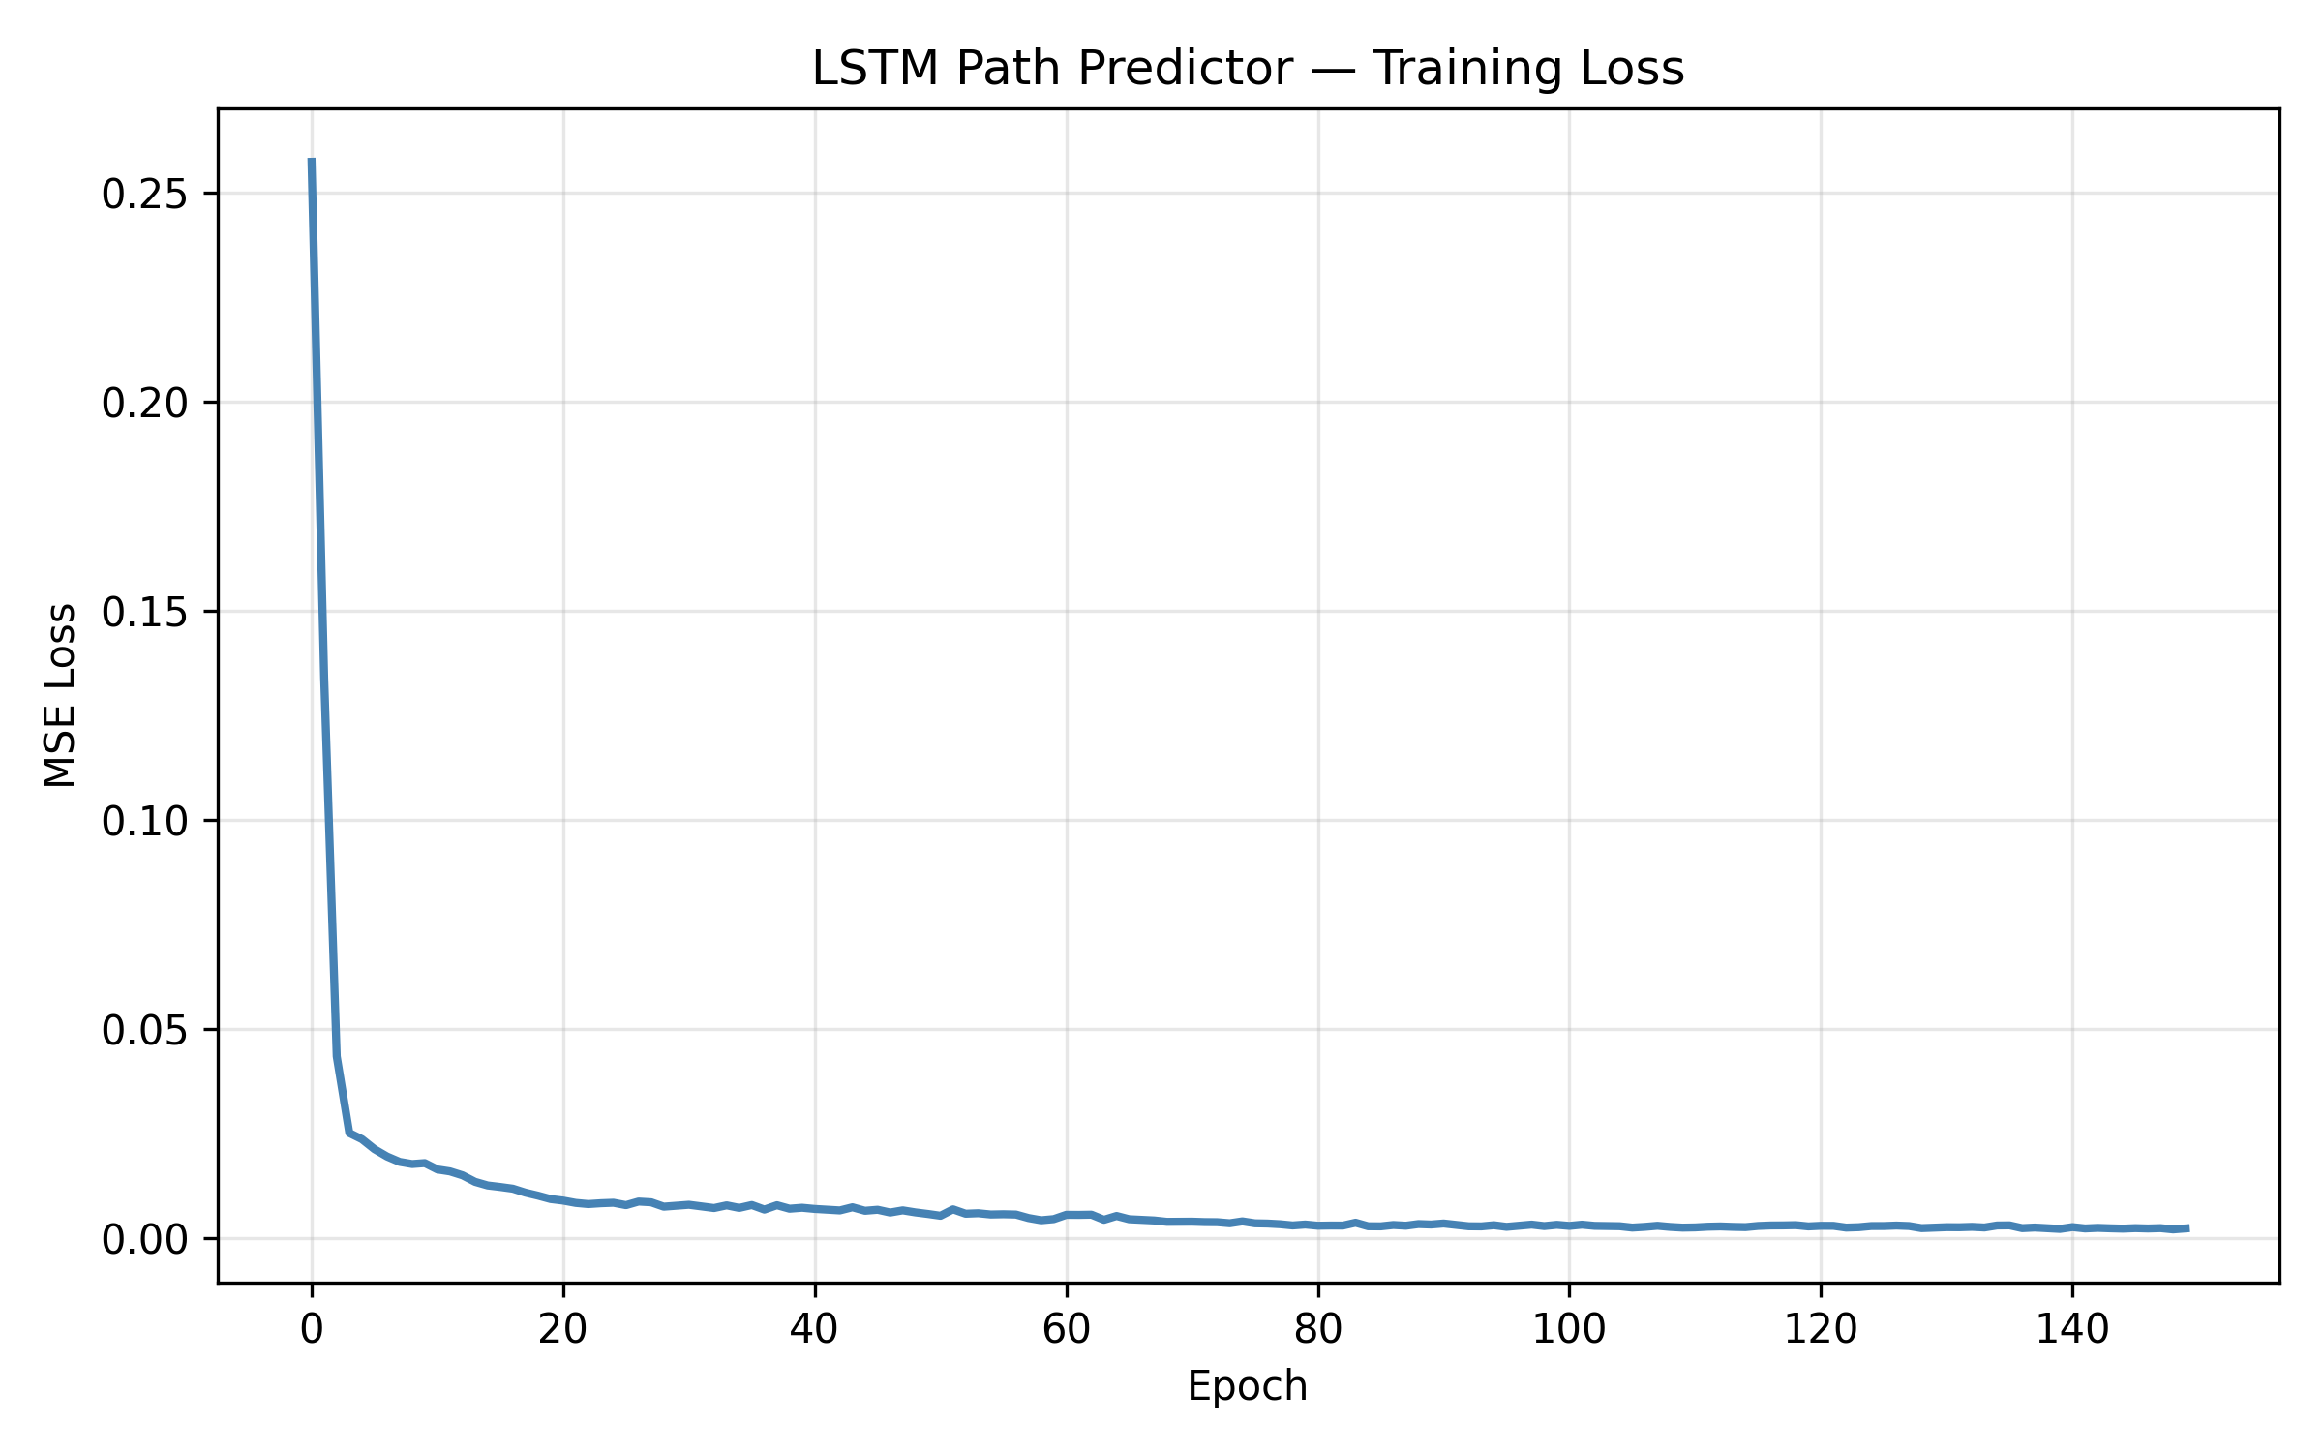
HUMAN MOVEMENT PREDICTION(LSTM)
Uses MediaPipe Pose landmarks to track human movement.
LSTM predicts the operator’s next movement direction.
Uses past movement patterns to anticipate future motion.
Helps the robot respond proactively instead of reactively.
Achieved 25.8 px ADE and 32.4 px FDE.
Figure 13: LSTM Path Predictor Training and Validation Loss Convergence

Slide 14

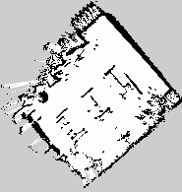
SLAM MAPPING AND LOCALISATION
SLAM Toolbox creates a 2D map using LiDAR and wheel odometry.
The environment is represented as an occupancy grid.
Nav2 enables point-to-point autonomous navigation.
AMCL localizes the robot on the generated map.
Costmaps help the robot avoid unexpected obstacles
Figure 13:Initial Run: “Hourglass” Rotational Drift Defect.
Figure 14:F inal Run (3rd Attempt): Clean Metric Map

Slide 15
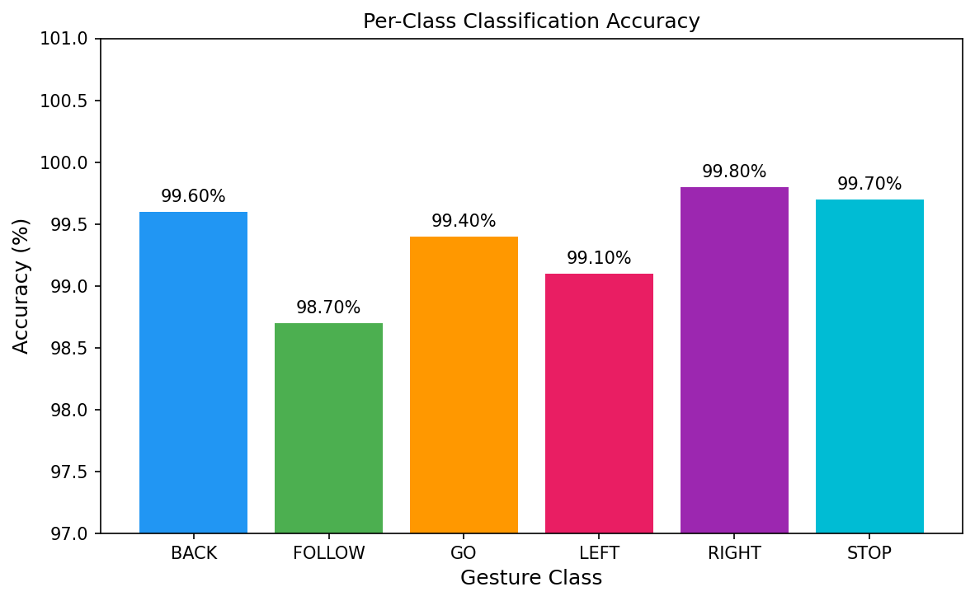
TESTING AND RESULTS
Gesture Recognition Physical Trial Results
Gesture | Total Trials | Successful Trials | Observed Accuracy (%)
Stop | 30 | 27 | 90.0%
Go | 30 | 29 | 96.7%
Folow | 30 | 28 | 93.3%
Left | 30 | 30 | 100.0%
Righ | 30 | 30 | 100.0%
Back | 30 | 30 | 100.0%
Aggregate | 180 | 174 | 96.67%
Figure 15:Per-Class Classification Accuracy of the Trained MLP Gesture Model

Slide 16
TESTING AND RESULTS
Movement Recognition Test Results
Movement Class | Observed Kinematic Behavior | Result
Approaching | Rapid expansion of bounding box area with stable center | Successfully Recognized
Moving Away | Continuous contraction of bounding box area with stable center | Successfully Recognized
Moving Left | Persistent leftward centroid translation across frames | Successfully Recognized
Moving Right | Persistent rightward centroid translation across frames | Successfully Recognized
Stationary | Centroid displacement within noise threshold (±4 px) | Successfully Recognized

Slide 17
CONCLUSION AND FUTURE WORKS
Conclusion
Future works
99.38% gesture recognition accuracy.
96.67% physical trial accuracy.
Successful human movement prediction.
ROS 2 integration achieved.
SLAM and Nav2 validated
Real-time edge operation achieved
Safe obstacle detection implemented
Multi-waypoint autonomous navigation.
Proactive human-aware navigation.
Follow-to-Map exploration.
NPU acceleration for AI tasks.
Improved gimbal–chassis control
Multi-sensor safety detection
Larger and more diverse testing.

Slide 18
REFERENCES
[1] D. Tsitos et al., “Real-Time Feasibility of a Human Intention Prediction Method Evaluated Through a Competitive Human–Robot Reaching Game,” IEEE Robotics and Automation Letters, vol. 7, no. 4, pp. 10034–10041, Oct. 2022.
[2] J. A. Mahmud, B. C. Das, J. Shin, K. M. Hasib, R. Sadik, and M. F. Mridha, “3D Gesture Recognition and Adaptation for Human–Robot Interaction,” IEEE Access, vol. 10, pp. 116485–116507, 2022.
[3] G. Yang, S. Wang, H. Okamura, Y. Ueda, T. Yasui, T. Yamada, Y. Miyazawa, S. Yoshida, Y. Inada, S. Ino, K. Okuhata, and Y. Mizobuchi, “Safe and Efficient Motion Planning for Material Transportation Robots Considering Intention Prediction of Obstacles,” in Proc. IEEE Int. Conf. Mechatronics Autom. (ICMA), Harbin, China, Aug. 2023, pp. 1179–1184.

Slide 19
Questions And Discussion
Thank you

